Slide 1
Concurrency Control
database transactions are performed concurrently without violating the data integrity of the respective databases.
To ensure correctness, a DBMS usually guarantees that only serializable transaction schedules are generated,

Slide 2
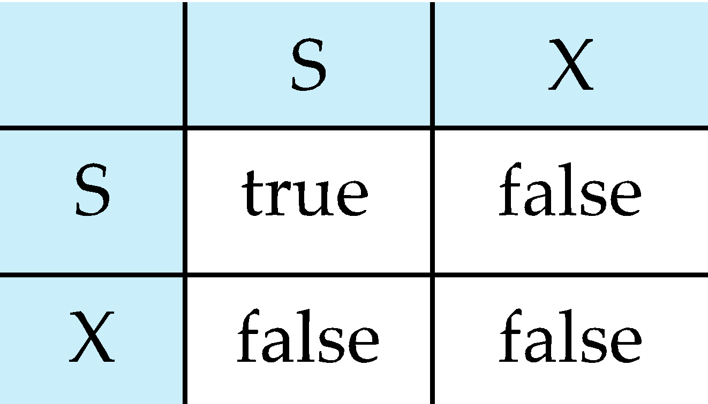
Atomocity Using Lock-Based Protocols
A lock is a mechanism to control concurrent access to a data item
Data items can be locked in two modes :
  exclusive (X) mode. Data item can be both read as well as written. X-lock is requested using lock-X instruction.
  shared (S) mode. Data item can only be read. S-lock is requested using lock-S instruction.
Lock requests are made to the concurrency-control manager by the transaction manager. Transaction can proceed only after request is granted.
Lock-compatibility matrix

Slide 3
Atomocity Using Lock-Based Protocols
Lock-compatibility matrix
T1 | T2 | T3 | Lock status
LOCK-S(A) |  |  | GRANT(A,T1)
READ(A)
 | LOCK-S(A) |  | GRANT(A,T2)
 | READ(A)
 |  | LOCK-X(A) | WAIT(A,T3)
 |  | WRITE(A)

Slide 4
Atomocity Using Lock-Based Protocols
Lock-compatibility matrix
T4 | T5 | T6 | Lock status
LOCK-X(A)
WRITE(A)
 | LOCK-S(A)
 | READ(A)
 |  | LOCK-X(A)
 |  | WRITE(A)
GRANT(A,T4)
WAIT(A,T5)
WAIT(A,T6)

Slide 5
Atomocity Using Lock-Based Protocols
Lock-compatibility matrix
T7 | T8 | T9 | Lock status
LOCK-X(A)
WRITE(A)
 | LOCK-X(B)
 | WRITE(B)
 |  | LOCK-X(C)
 |  | WRITE(C)
GRANT(A,T7)
GRANT(B,T8)
GRANT(C,T9)

Slide 6
Atomocity Using Lock-Based Protocols
Lock-compatibility matrix
Question Put appropriate lock and show lock status
T1 | T2 | T3 | T4 | LOCK STATUS
READ(P)
 | WRITE(Q)
 |  | READ(P)
 |  |  | WRITE(P)

Slide 7
Lock-Based Protocols
A lock is a mechanism to control concurrent access to a data item
Data items can be locked in two modes :
1. exclusive (X) mode. Data item can be both read as well as
written. X-lock is requested using lock-X instruction.
2. shared (S) mode. Data item can only be read. S-lock is
requested using lock-S instruction.
Lock requests are made to concurrency-control manager. Transaction can proceed only after request is granted.

Slide 8

Lock-Based Protocols (Cont.)
Lock-compatibility matrix
A transaction may be granted a lock on an item if the requested lock is compatible with locks already held on the item by other transactions
Any number of transactions can hold shared locks on an item,
  but if any transaction holds an exclusive on the item no other transaction may hold any lock on the item.
If a lock cannot be granted, the requesting transaction is made to wait till all incompatible locks held by other transactions have been released. The lock is then granted.

Slide 9
Lock-Based Protocols (Cont.)
Example of a transaction performing locking:
T₂: lock-S(A);
read (A);
unlock(A);
lock-S(B);
read (B);
unlock(B);
display(A+B)
Locking as above is not sufficient to guarantee serializability — if A and B get updated in-between the read of A and B, the displayed sum would be wrong.
A locking protocol is a set of rules followed by all transactions while requesting and releasing locks. Locking protocols restrict the set of possible schedules.

Slide 10

Pitfalls of Lock-Based Protocols
Consider the partial schedule
Neither T₃ nor T₄ can make progress — executing lock-S(B) causes T₄ to wait for T₃ to release its lock on B, while executing lock-X(A) causes T₃ to wait for T₄ to release its lock on A.
Such a situation is called a deadlock.
  To handle a deadlock one of T₃ or T₄ must be rolled back
  and its locks released.

Slide 11
Pitfalls of Lock-Based Protocols (Cont.)
The potential for deadlock exists in most locking protocols. Deadlocks are a necessary evil.
Starvation is also possible if concurrency control manager is badly designed. For example:
  A transaction may be waiting for an X-lock on an item, while a sequence of other transactions request are granted an S-lock on the same item.
  The same transaction is repeatedly rolled back due to deadlocks.
Concurrency control manager can be designed to prevent starvation.
T1 | T2 | T3 | T4 | LOCK STATUS
READ(P)
 | WRITE(P)
 |  | READ(P)
 |  |  | READ(P)
GRANT
WAIT
GRANT
GRANT

Slide 12
The Two-Phase Locking Protocol
This is a protocol which ensures conflict-serializable schedules.
Phase 1: Growing Phase
  transaction may obtain locks
  transaction may not release locks
Phase 2: Shrinking Phase
  transaction may release locks
  transaction may not obtain locks
The protocol assures serializability. It can be proved that the transactions can be serialized in the order of their lock points (i.e. the point where a transaction acquired its final lock).

Slide 13
The Two-Phase Locking Protocol (Cont.)
Two-phase locking does not ensure freedom from deadlocks
Cascading roll-back is possible under two-phase locking. To avoid this, follow a modified protocol called strict two-phase locking. Here a transaction must hold all its exclusive locks till it commits/aborts.
Rigorous two-phase locking is even stricter: here all locks are held till commit/abort. In this protocol transactions can be serialized in the order in which they commit.

Slide 14
Lock Conversions
Two-phase locking with lock conversions:
– First Phase:
  can acquire a lock-S on item
  can acquire a lock-X on item
  can convert a lock-S to a lock-X (upgrade)
– Second Phase:
  can release a lock-S
  can release a lock-X
  can convert a lock-X to a lock-S (downgrade)
This protocol assures serializability. But still relies on the programmer to insert the various locking instructions.

Slide 15
Automatic Acquisition of Locks
A transaction T_{i} issues the standard read/write instruction, without explicit locking calls.
The operation read(D) is processed as:
if T_{i} has a lock on D
then
read(D)
else begin
if necessary wait until no other
transaction has a lock-X on D
grant T_{i} a lock-S on D;
read(D)
end

Slide 16
Automatic Acquisition of Locks (Cont.)
write(D) is processed as:
if T_{i} has a lock-X on D
then
write(D)
else begin
if necessary wait until no other trans. has any lock on D,
if T_{i} has a lock-S on D
then
upgrade lock on D to lock-X
else
grant T_{i} a lock-X on D
write(D)
end;
All locks are released after commit or abort

Slide 17
Implementation of Locking
A lock manager can be implemented as a separate process to which transactions send lock and unlock requests
The lock manager replies to a lock request by sending a lock grant messages (or a message asking the transaction to roll back, in case of a deadlock)
The requesting transaction waits until its request is answered
The lock manager maintains a data-structure called a lock table to record granted locks and pending requests
The lock table is usually implemented as an in-memory hash table indexed on the name of the data item being locked

Slide 18
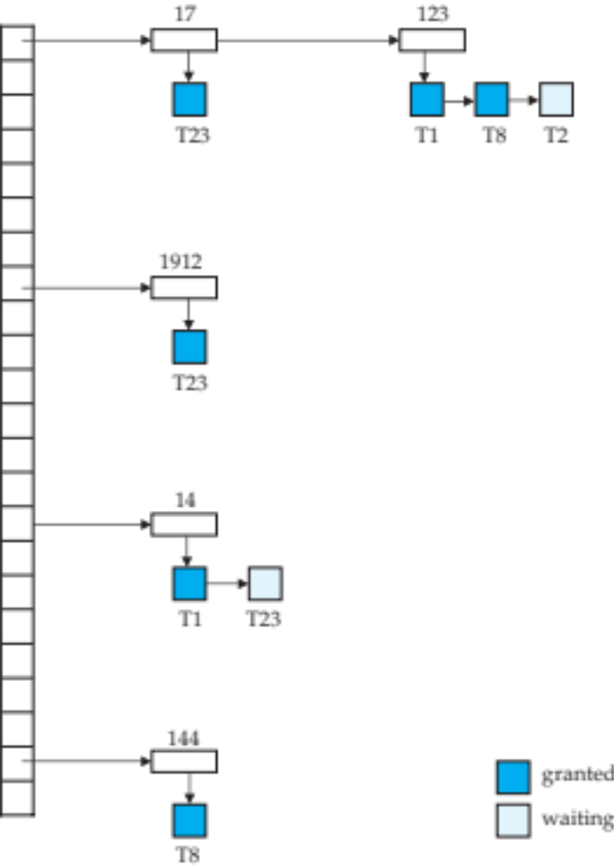
Lock Table
Locking
Black rectangles indicate granted locks, white ones indicate waiting requests
Lock table also records the type of lock granted or requested
New request is added to the end of the queue of requests for the data item, and granted if it is compatible with all earlier locks
Question: Enter LOCK-S (123) by T5

Slide 19
Lock Table
Unlocking
Unlock requests result in the request being deleted, and later requests are checked to see if they can now be granted
If transaction aborts, all waiting or granted requests of the transaction are deleted
  lock manager may keep a list of locks held by each transaction, to implement this efficiently
Question: What will happen in lock table after ABORT (T1) and ABORT (T8)?

Slide 20
Question:
The transactions and locking status are given as follows:
T1 has 4 locks on A, D, G and K with grant status. T2 has three locks on D, G and K with status grant for all. T3 has 4 locks on A, D, G and K with all waiting status. The hash values for characters A to F is 5 and G to J is 15 and K to N is 10.
Construct the lock table and find the lock type (Lock-X or Lock-S) of T2.

Slide 21
Database Recovery System

Slide 22
Recovery System
Failure Classification
Storage Structure
Recovery and Atomicity
Log-Based Recovery

Slide 23
Failure Classification
Transaction failure :
  Logical errors: transaction cannot complete due to some internal error condition
  System errors: the database system must terminate an active transaction due to an error condition (e.g., deadlock)
System crash: a power failure or other hardware or software failure causes the system to crash.
  Fail-stop assumption: non-volatile storage contents are assumed to not be corrupted by system crash
    Database systems have numerous integrity checks to prevent corruption of disk data
Disk failure: a head crash or similar disk failure destroys all or part of disk storage
  Destruction is assumed to be detectable: disk drives use checksums to detect failures

Slide 24
Recovery Algorithms
Consider transaction T_{i} that transfers $50 from account A to account B
  Two updates: subtract 50 from A and add 50 to B
Transaction T_{i} requires updates to A and B to be output to the database.
  A failure may occur after one of these modifications have been made but before both of them are made.
  Modifying the database without ensuring that the transaction will commit may leave the database in an inconsistent state
  Not modifying the database may result in lost updates if failure occurs just after transaction commits
Recovery algorithms have two parts
  Actions taken during normal transaction processing to ensure enough information exists to recover from failures
  Actions taken after a failure to recover the database contents to a state that ensures atomicity, consistency and durability

Slide 25
Storage Structure
Volatile storage:
  Does not survive system crashes
  Examples: main memory, cache memory
Nonvolatile storage:
  Survives system crashes
  Examples: disk, tape, flash memory, non-volatile RAM
  But may still fail, losing data
Stable storage:
  A mythical form of storage that survives all failures
  Approximated by maintaining multiple copies on distinct nonvolatile media

Slide 26
Data Access
Physical blocks are those blocks residing on the disk.
Buffer blocks are the blocks residing temporarily in main memory.
Block movements between disk and main memory are initiated through the following two operations:
  input (B) transfers the physical block B to main memory.
  output (B) transfers the buffer block B to the disk, and replaces the appropriate physical block there.
We assume, for simplicity, that each data item fits in, and is stored inside, a single block.

Slide 27
Data Access (Cont.)
Each transaction T_{i} has its private work-area in which local copies of all data items accessed and updated by it are kept.
  T_{i} 's local copy of a data item X is called x_{i}.
Transferring data items between system buffer blocks and its private work-area done by:
  read(X) assigns the value of data item X to the local variable x_{i}.
  write(X) assigns the value of local variable x_{i} to data item {X} in the buffer block.
  Note: output(B_{X}) need not immediately follow write(X). System can perform the output operation when it deems fit.

Slide 28
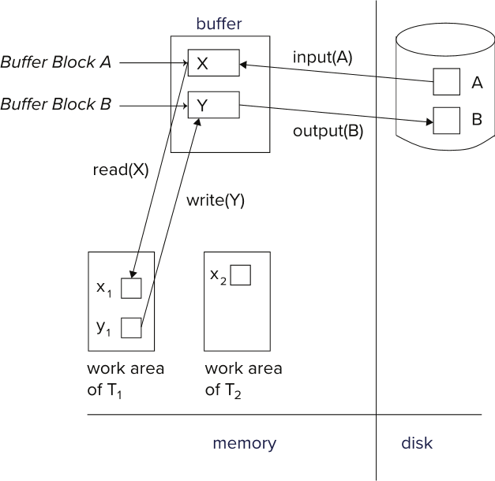
Example of Data Access
Question:
Explain the transaction processing by DBMS showing the transaction work area in memory, the buffer and the database in disk.

Slide 29
Recovery and Atomicity
To ensure atomicity despite failures, we first output information describing the modifications to stable storage without modifying the database itself.
We study log-based recovery mechanisms in detail
  We first present key concepts
  And then present the actual recovery algorithm

Slide 30
Log-Based Recovery
A log is kept on stable storage.
  The log is a sequence of log records, which maintains information about update activities on the database.
When transaction T_{i} starts, it registers itself by writing a record
<T_{i} start>
to the log
Before T_{i} executes write(X), a log record
<T_{i}, X, V₁, V₂>
is written, where V₁ is the value of X before the write (the old value), and V₂ is the value to be written to X (the new value).
When T_{i} finishes it last statement, the log record <T_{i} commit> is written.
Two approaches using logs
  Immediate database modification
  Deferred database modification

Slide 31
Log-Based Recovery
When transaction T_{i} starts, it registers itself by writing a record
<T_{i} start>
to the log
Before T_{i} executes write(X), a log record
<T_{i}, X, V₁, V₂>
is written, where V₁ is the value of X before the write (the old value), and V₂ is the value to be written to X (the new value).
When T_{i} finishes it last statement, the log record <T_{i} commit> is written.
Question: The accounts A, B, C has the balances 500, 1000 and 1500 respectively. Write a transaction where 20% of C account will deducted and equally divided into two accounts A and B. Write log records for the transaction.

Slide 32
Database Modification
The immediate-modification scheme allows updates of an uncommitted transaction to be made to the buffer, or the disk itself, before the transaction commits
Update log record must be written before a database item is written
  We assume that the log record is output directly to stable storage
Output of updated blocks to disk storage can take place at any time before or after transaction commit
Order in which blocks are output can be different from the order in which they are written.

Slide 33
Database Modification
The deferred-modification scheme performs updates to buffer/disk only at the time of transaction commit
  Simplifies some aspects of recovery
  But has overhead of storing local copy
We cover here only the immediate-modification scheme

Slide 34
Transaction Commit
A transaction is said to have committed when its commit log record is output to stable storage
  All previous log records of the transaction must have been output already
Writes performed by a transaction may still be in the buffer when the transaction commits, and may be output later

Slide 35
Immediate Database Modification Example
Log Write Output
<T₀ start>
<T₀, A, 1000, 950>
<T_{o}, B, 2000, 2050>
A = 950
B = 2050
<T₀ commit>
<T₁ start>
<T₁, C, 700, 600>
C = 600
B_{B} , B_{C}
<T₁ commit>
B_{A}
Note: B_{X} denotes block containing X.
B_{C} output before T₁ commits
B_{A} output after T₀ commits

Slide 36
Undo and Redo Operations
Undo of a log record <T_{i}, X, V₁, V₂> writes the old value V₁ to X
Redo of a log record <T_{i}, X, V₁, V₂> writes the new value V₂ to X
Undo and Redo of Transactions
  undo(T_{i}) restores the value of all data items updated by T_{i} to their old values, going backwards from the last log record for T_{i}
    Each time a data item X is restored to its old value V a special log record (called redo-only) <T_{i} , X, V> is written out
    When undo of a transaction is complete, a log record
    <T_{i} abort> is written out (to indicate that the undo was completed)
  redo(T_{i}) sets the value of all data items updated by T_{i} to the new values, going forward from the first log record for T_{i}
    No logging is done in this case

Slide 37
Undo and Redo Operations (Cont.)
The undo and redo operations are used in several different circumstances:
  The undo is used for transaction rollback during normal operation(in case a transaction cannot complete its execution due to some logical error).
  The undo and redo operations are used during recovery from failure.
We need to deal with the case where during recovery from failure another failure occurs prior to the system having fully recovered.

Slide 38
Transaction rollback (during normal operation)
Let T_{i} be the transaction to be rolled back
Scan log backwards from the end, and for each log record of T_{i} of the form <T_{i}, X_{j}, V₁, V₂>
  Perform the undo by writing V₁ to X_{j},
  Write a log record <T_{i} , X_{j}, V₁>
    such log records are called compensation log records
Once the record <T_{i} start> is found stop the scan and write the log record <T_{i} abort>

Slide 39
Undo and Redo on Recovering from Failure
When recovering after failure:
  Transaction T_{i} needs to be undone if the log
    contains the record <T_{i} start>,
    but does not contain either the record <T_{i} commit> or <T_{i} abort>.
  Transaction T_{i} needs to be redone if the log
    contains the records <T_{i} start>
    and contains the record <T_{i} commit> or <T_{i} abort>
  It may seem strange to redo transaction T_{i} if the record <T_{i} abort> record is in the log. To see why this works, note that if <T_{i} abort> is in the log, so are the redo-only records written by the undo operation. Thus, the end result will be to undo T_{i} 's modifications in this case. This slight redundancy simplifies the recovery algorithm and enables faster overall recovery time.
    such a redo redoes all the original actions including the steps that restored old value. Known as repeating history

Slide 40
Undo and Redo on Recovering from Failure
When recovering after failure:
  Transaction T_{i} needs to be undone if the log
  contains the record <T_{i} start>,
  but does not contain either the record <T_{i} commit> or
  <T_{i} abort>.
  Transaction T_{i} needs to be redone if the log
    contains the records <T_{i} start>
    and contains the record <T_{i} commit> or <T_{i} abort>
Question: The accounts E, F, G has the balances 500, 1000 and 1500 respectively. There are three transactions T1, T2 and T3. Discuss UNDO and REDO operations for the following cases:
<T1 start> log record is found in the log
<T1 start>
<T1, E, 500, 400>
<T1 COMMIT> is found in the log
<T1 start>
<T1, E, 500, 400>
<T1 COMMIT>
<T2 start>
<T2, F, 1000, 1100>
<T2 COMMIT>
<T3 start>
<T3, G, 1500, 1800>
…. is found in the log

Slide 41

Immediate Modification Recovery Example
Below we show the log as it appears at three instances of time.
Recovery actions in each case above are:
(a) undo (T₀): B is restored to 2000 and A to 1000, and log records
<T₀, B, 2000>, <T₀, A, 1000>, <T₀, abort> are written out
(b) redo (T₀) and undo (T₁): A and B are set to 950 and 2050 and C is restored to 700. Log records <T₁, C, 700>, <T₁, abort> are written out.
(c) redo (T₀) and redo (T₁): A and B are set to 950 and 2050
respectively. Then C is set to 600

Slide 42
Checkpoints
Redoing/undoing all transactions recorded in the log can be very slow
  Processing the entire log is time-consuming if the system has run for a long time
  We might unnecessarily redo transactions which have already output their updates to the database.
Streamline recovery procedure by periodically performing checkpointing
  All updates are stopped while doing checkpointing
  Output all log records currently residing in main memory onto stable storage.
  Output all modified buffer blocks to the disk.
  Write a log record < checkpoint L> onto stable storage where L is a list of all transactions active at the time of checkpoint.

Slide 43
Checkpoints (Cont.)
During recovery we need to consider only the most recent transaction T_{i} that started before the checkpoint, and transactions that started after T_{i}.
  Scan backwards from end of log to find the most recent <checkpoint L> record
  Only transactions that are in L or started after the checkpoint need to be redone or undone
  Transactions that committed or aborted before the checkpoint already have all their updates output to stable storage.
Some earlier part of the log may be needed for undo operations
  Continue scanning backwards till a record <T_{i} start> is found for every transaction T_{i} in L.
  Parts of log prior to earliest <T_{i} start> record above are not needed for recovery, and can be erased whenever desired.
Question: Why is checkpoint used in log based recovery systems?

Slide 44
Example of Checkpoints
T_{c}
T_{f}
T₁ can be ignored (updates already output to disk due to checkpoint)
T₂ and T₃ redone.
T₄ undone
T₁
T₂
T₃
T₄
checkpoint
system failure

Slide 45
Example of Checkpoints
T_{c}
T_{f}
T₁
T₂
T₃
T₄
checkpoint
system failure
Question: Show in a diagram, recovery is performed when failure is occurred after checkpoint with the following transactions and statuses:
T1 committed before checkpoint.
T2, T3 started before checkpoint but committed after checkpoint.
T5, T6 started after checkpoint and committed after checkpoint.
T7 started after checkpoint but not committed and system failed

